Slide 1
GEO 2012-15 Work Plan rev 1.1 HEALTH SBA Two Tasks Six Task Components Health and Ecosystems Targets

Slide 2
Understanding environmental factors affecting human health & well-being
01 Tools and Information for Health Decision-Making
Air-borne Diseases, Air Quality & Aeroallergens
Water-borne Diseases, Water Quality and Risk
Vector-borne Diseases
A Holistic Approach to Health: Transmission Dynamics, Urban Health Forecasting, Linkages and New Technologies
02 Tracking Pollutants
Global Mercury Observation System
Global Monitoring of Persistent Organic Pollutants, Emerging Contaminants and Global Change Indicators

Slide 3
HE-01 Tools and Information for Health Decision-Making
Related GEOSS Strategic Target(GEO-VI Doc 12 Rev1)
Health:
Access to improved environmental information and tools to support the global community of human health and environment experts.
Increased use of environmental information and tools to support decision making in epidemics and/or disease management and planning for well-being.
Applying outcomes from other Societal Benefit Areas to improve health and well-being.

Slide 4
HE-02 Tracking Pollutants
Related GEOSS Strategic Target(GEO-VI Doc 12 Rev1)
Health: Access to improved environmental information and tools to support the global community of human health and environment experts. Increased use of environmental information and tools to support decision making in epidemics and/or disease management and planning for well-being.
Ecosystems: Increased operational monitoring of major ecosystems on land on an annual basis. Increased operational monitoring of major marine and coastal ecosystems on an annual basis.

Slide 5
HEALTH SBA TASKS AND TARGETS
Health
Target
Ecosystems
Target
- - - - - -To be demonstrated by - - - - - -
HE-01 Tools
& Info for
Health DM
HE-02
Tracking
Pollutants
C1
AQ
C3
VBorne
HE-02
Task
Team
HE-01
Task
Team
C1
Mercury
C2 POPs, etc
C2
WQ
C4
Holistic
To Be Implemented
in Connection with
To Be Implemented
in Connection with
SB-01 SB-04
HE-01 WA-01
EC-01 BI-01
SB-01 DI-01 AG-01
CL-01 WE-01 HE-01 WA-01 EC-01 BI-01

Slide 6
GEO WORK PLAN SYMPOSIUM 2012 General Advice
The relevance of the information contained in the Component Sheets to monitoring should be high. In particular . . . .
Statements of activities & outputs should be clear and concrete.
Statements should be objectively verifiable. It should be possible to determine later whether or not the activity or output was completed as planned.
Vague adjectives should be avoided, such as “improved”, “enhanced”. What should be described should be “what will be improved and in what way”.
Outputs should not be phrased as actions (should not include verbs). They should also not be outcomes.
Activities should not repeat the output, e.g. “Develop report on…”. In general, there should be more activities than outputs
Each activity and output should be a single, discrete item.

Slide 7
HEALTH SBA TASKS AND GOVERNANCE
Health
Target
Ecosystems
Target
- - - - - -To be demonstrated by - - - - - -
HE-01 Tools
& Info for
Health DM
Societal Benefit
Implementation Board
HE-02
Tracking
Pollutants
Reports to
ExCom
Reports to
ExCom
C1
AQ
C3
VBorne
Review and Integration
of Component Outputs
And Outcomes
HE-02
Task
Team
HE-01
Task
Team
C1
Mercury
C2 POPs, etc
C2
WQ
C4
Holistic
To Be Implemented
in Connection with
To Be Implemented
in Connection with
SB-01 SB-04
HE-01 WA-01
EC-01 BI-01
SB-01 DI-01 AG-01
CL-01 WE-01 HE-01 WA-01 EC-01 BI-01

Slide 8
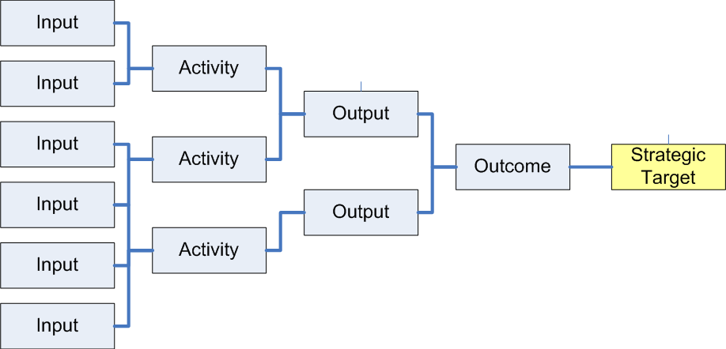
Aspects of Monitoring by Implementation Boards
Were the outputs produced as expected?
Are performance indicator values consistent with expectations?
Did the activities occur as planned?
Were all of the planned inputs provided?

Slide 9
GEO 2012-2015 Work Plan Progress Report to ExCom July 2012 – HE-01
Task Overview of Progress
The Health Community of Practice worked to reorganize its strategy and activities under the new Work Plan structure.
This resulted into an end-to-end approach to each area (airborne diseases and air quality, water-borne diseases, vector-borne diseases), and a holistic approach to health services (urban health forecasting, infectious disease emergence and spread).
While individual projects made progress in their respective areas, the Community of Practice is working to design a “bigger picture” for the Health Societal Benefit Area, trying to identify priority areas, resources and people who are able to contribute to the Task.

Slide 10
GEO 2012-2015 Work Plan Progress Report to ExCom July 2012 – HE-01
Highlights (see details below)
• Test performed on a meningitis predictive model to meet information needs for reactive and preventive vaccination. Protocol prepared for testing in Benin, Togo, Nigeria, and Chad
• Influenza data jointly analyzed by USA and numerous countries in Europe and Africa
• International online comparison of dust forecasts underway
• Feasibility of using remotely-sensed data as a proxy for in-situ air pollution levels under study
• Hot-spots of cholera infections and related high cholera risk areas located
• New initiative launched to improve prediction, detection of, and intervention on Leptospirosis

Slide 11
GEO 2012-2015 Work Plan Progress Report to ExCom July 2012 – HE-01
Actions Needed from GEO Members and Participating Organizations
Additional Resources and/or Contributions
• Ensure health national/international activities are connected to the present Task
• Encourage WHO to become a Participating Organization in GEO

Slide 12
GEO 2012-2015 Work Plan Progress Report to ExCom July 2012 – HE-02
Task Overview of Progress
Thanks to sound financial backing, the development of a global observation system for mercury is advancing well. Also, the implementation of the global monitoring plan for persistent organic pollutants (Phase II) is making progress, consistently with the terms of the Stockholm Convention.
Activities to monitor pollutants and their compounds in air, water, soil, vegetation and biota mainly relate to mercury and persistent organic pollutants. Efforts could be extended to additional pollutants pending on further contributions by GEO Members and Participating Organizations.

Slide 13
GEO 2012-2015 Work Plan Progress Report to ExCom July 2012 – HE-02
Highlights (see details below)
• Ground-based observing system for mercury established
• Oceanographic campaigns performed over Mediterranean Sea and Atlantic Ocean
• Spatial Data Infrastructure (SDI) for mercury designed and structured
• Networking activities ongoing to develop capacity and improve instrumentation and system design
• Persistent Organic Pollutants (POP) concentration data in ambient air, human blood and milk evaluated; major drawbacks identified
• Baseline data gathered for 10 new POPs listed in Stockholm Convention
• 1st version of POP Global Monitoring Plan portal online and data visualization tools developed

Slide 14
GEO 2012-2015 Work Plan Progress Report to ExCom July 2012 – HE-02
Actions Needed from GEO Members and Participating Organizations
Technical
• Increase advocacy for in-situ Quality Assurance/Quality Control procedures
• Develop more advanced sensors for Mercury and POPs to make observing systems less human dependent
Management
• Encourage active participation from Leads/Contributors and development of new projects
• Establish a close cooperation/coordination with Infrastructure Tasks
Additional Resources and/or Contributions
• Ensure national/international participation in pollutant monitoring activities

Slide 15
HEALTH SBA TASKS AND GOVERNANCE
Health
Target
Ecosystems
Target
- - - - - -To be demonstrated by - - - - - -
HE-01 Tools
& Info for
Health DM
Societal Benefit
Implementation Board
HE-02
Tracking
Pollutants
Reports to
ExCom
Reports to
ExCom
C1
AQ
C3
VBorne
Review and Integration
of Component Outputs
And Outcomes
HE-02
Task
Team
HE-01
Task
Team
C1
Mercury
C2 POPs, etc
C2
WQ
C4
Holistic
Health and Environment CoP
To Be Implemented
in Connection with
To Be Implemented
in Connection with
SB-01 SB-04
HE-01 WA-01
EC-01 BI-01
SB-01 DI-01 AG-01
CL-01 WE-01 HE-01 WA-01 EC-01 BI-01
Review and Integration
of Component Activities
& connections with WP tasks

Slide 16
Health and Environment CoP
This CoP both implements and oversees many of the ongoing projects in GEO’s Work Plan.
Meetings:
July 2009 – Geneva (formation of the CoP)
Dec 2009 – Washington (Health Workshop)
July 2010 – Paris (task status review)
Mar 2011 – Geneva (proposed the new WP 2012-15 tasks & components.)
Aug 2012 – Karlsruhr (task status review)

Slide 17
GEO Health & Environment Community of Practice, 4th Workshop, 25-27 July 2012
The goals of the workshop:
review the report on the former workshop,
prepare for the next GEO Plenary,
discuss the progress of Task Components,
discuss collaboration with other groups like GFCS,
plan to coordinate with other tasks, and
discuss the health task resources, data and information gaps and other concerns.
ftp://ftp.earthobservations.org/meetings/201207_4th_geo_healthenv_karlsruhe_germany/

Slide 18
Highlights from CoP Meeting
Updates on:
Links with WHO and « watsan » projects
EO2Heaven project
Durban and Uganda case studie
Mobile phone application for cholera patient tracking
Cholera outbreak early warning system
NASA Health and Air Quality Applications
Potential synergies with Water SBA

Slide 19
Next Steps from Health CoP Workshop
Complete Task Component sheets
– C1 sheet – teleconference
– C3 PoC submitted
– C4 additional inputs requested
Teleconferences
– WQ + CoP
– Task-Level (all Component Leads) bi-monthly
– CoP bi-monthly (alternate with Task-level)

